Slide 1


Slide 2
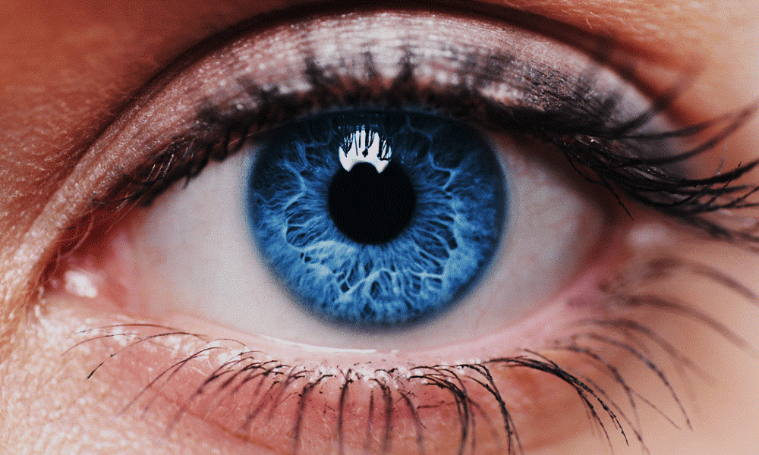
The real voyage of discovery consists not in seeking new landscapes, but in having new eyes.

Slide 3



Q & A
You can find us at:-
amit_rage
Amit Saraswat
kushagra.1429
Kushagra Mittal
abhijeet_9871
Abhijeet Negi

Slide 4
"A great presentation gives smart
ideas an advantage." - Nancy Duarte. "

